Slide 1

Financial market project Post graduate diploma in data science Werner Visser Student id: 4295158847 Part of the Financial Markets team (Pablo, OKSANA, BARRY, FINN, ISMAEL, Zuzanna)

Slide 2

Project background
Global Market Interconnectedness
This project seeks to analyse the interconnectedness of major global equity markets following a period of significant systemic shocks.
The study focuses on six major global market indices—Nifty 50 (India), Dow Jones Index, Nasdaq (United States), Hang Seng (Hong Kong), Nikkei 225 (Japan), and DAX (Germany)—alongside the VIX (Volatility Index or 'Fear Factor').
The primary period of analysis covers daily returns from 2019 to 2024.
We observed a clear volatility cycle: a sharp expansion during the 2020 global shock (COVID-19) followed by contraction as markets stabilized.
The analysis confirms that shocks in major economies (e.g., the U.S.) transmit globally but with varying intensity across regions.
“When you stand still long enough to see the pattern, the world starts making sense.”

Slide 3
Project background
Predictive Goal
The core objective is to determine whether movements in global indices and volatility act as significant indicators for the daily opening direction of the Nifty 50.
This insight is foundational for subsequent predictive modelling, where global co-movements serve as explanatory features for Nifty's directional dynamics.
We aim to integrate metrics capturing risk appetite and stress dynamics (like the VIX) at the start of the day to enhance predictive frameworks.
The analysis includes an examination of short-term sentiment spillover, such as how often global indices record a positive daily return when the Nifty opens strong.
“Every insight begins as a moment of openness.”

Slide 4
Data inputs
DATA SOURCES
Yahoo Finance via its python package
“yfinance”
This project draws on two primary data sources that together form the foundation of the analysis.
The first source is Yahoo Finance, accessed programmatically through Python’s yfinance package, which provided daily price and return data for major global market indices.
This dataset enabled the creation of a comprehensive master table used throughout the modelling and exploratory analysis phases.
The second input is a Synthetic Financial Tweet Corpus, generated in Python using real NIFTY50 return data to simulate market-aware tweets.
This allowed the project to incorporate sentiment analysis without relying on paid Twitter API access.
Together, these two inputs support both the quantitative market modelling and the text-based sentiment components of the project.
Synthetic Financial Tweet Corpus generated in Python from NIFTY50 return data

Slide 5

Data snapshot
The Master Data was finalized after several cleaning and transformation steps:
Daily Returns Calculation: Calculated based on close prices: (Y_{t}-Y_{t-1})/Y_{t-1}\times 100.
Data Merging: All index files were merged using an outer join, noting that global holidays differ.
Missing Data Imputation: Missing data (due to holidays or non-trading days) were imputed using the Linear interpolation method.
Indicator Variables: Indicator variables for "Year," "Quarter," and "Month" were created to support time-series analysis.
Target Variable: The dependent variable, Nifty_Open_Dir, was created, defined as 1 if the Nifty 50 Open at time t is greater than the Close at t-1, and 0 otherwise.

Slide 6
objectives
1. Build a unified financial market dataset
Combine global index data (Nifty, Dow Jones, Nasdaq, Hang Seng, Nikkei, DAX, VIX) into a structured master table.
2. Analyse market behaviour over time
Examine volatility, return patterns, and correlations across indices.
Identify key periods such as COVID-19 volatility spikes and post-pandemic stabilisation.
3. Predict short-term index direction
Develop classical statistical and machine-learning models to forecast Nifty50 opening direction based on global market movements.
4. Compare modelling approaches
Evaluate logistic regression, decision trees, random forests, and other classifiers.
Assess accuracy, confusion matrices, ROC curves, and AUC to determine the best-performing model.
5. Integrate text sentiment with market analysis
Generate a large corpus of synthetic, market-aware tweets for NLP and sentiment classification.
Analyse how sentiment shifts correspond to market movements.
6. Demonstrate a full end-to-end data-science pipeline
Data collection → cleaning → feature engineering → EDA → modelling → evaluation → text mining.
Present insights and actionable findings supported by visualisation and statistical evidence.

Slide 7
Analysis plan
Data Preparation
Downloaded global index data (Nifty, Dow Jones, Nasdaq, Hang Seng, Nikkei, DAX, VIX) using yfinance.
Cleaned and merged all indices into a single master dataset (2018–2024).
Calculated daily percentage returns and created date-based features (year, month, quarter).
Exploratory Data Analysis
Analysed return distributions and volatility trends.
Produced year-by-year boxplots to compare market behaviour (including COVID period).
Computed correlation matrices to examine inter-market relationships.
Project Aim
Understand global market movements and their relationships.
Explore whether global returns help explain Nifty direction.
Extend the analysis using tweet sentiment generated from market behaviour.

Slide 8
Analysis plan (Continued)
Modelling
Built classical models (e.g., logistic regression) to assess relationships between global returns and Nifty direction.
Trained machine-learning models including Decision Trees and Random Forests.
Compared model performance using accuracy, confusion matrices, and ROC–AUC scores.
Sentiment Analysis
Generated a synthetic corpus of NIFTY50-styled tweets using a custom Python script.
Extracted sentiment scores (compound, positive, negative, neutral) using VADER.
Analysed sentiment distribution and linked it back to market tone.
Outputs Produced
- Summary statistics and EDA visualisations.
- Model performance tables and ROC curves.
- Sentiment bar charts and tweet-based insights.

Slide 9

Challenges
Challenge: Missing Market Data on Certain Dates Financial markets do not trade every day. Weekends, holidays, or index-specific closures created gaps in the dataset. This caused breaks in the time series and made return calculations inconsistent.
Solution Implemented:
First, removed all weekends and excluded 1 January each year (a known global holiday) to avoid artificially creating missing values.
For any remaining gaps, applied linear interpolation separately to the Open and Close prices. This method filled only the missing values while preserving all real data points and maintaining smooth, realistic market transitions.
Challenge: Access to Twitter Market Data Authentic historical financial tweets were locked behind paid APIs (Twitter/X Developer access), making direct sentiment extraction impossible.
Solution Implemented:
Built a custom Python tweet generator that produced realistic, market-aware tweets based on actual NIFTY50 return behaviour.
The script mapped daily returns to tone categories (e.g., strong_up, down, flat) and generated linguistically diverse tweets using predefined vocabulary, emojis, macro terms, and timestamps.
This allowed creation of a large, sentiment-rich corpus suitable for NLP and VADER analysis without requiring paid API access.

Slide 10
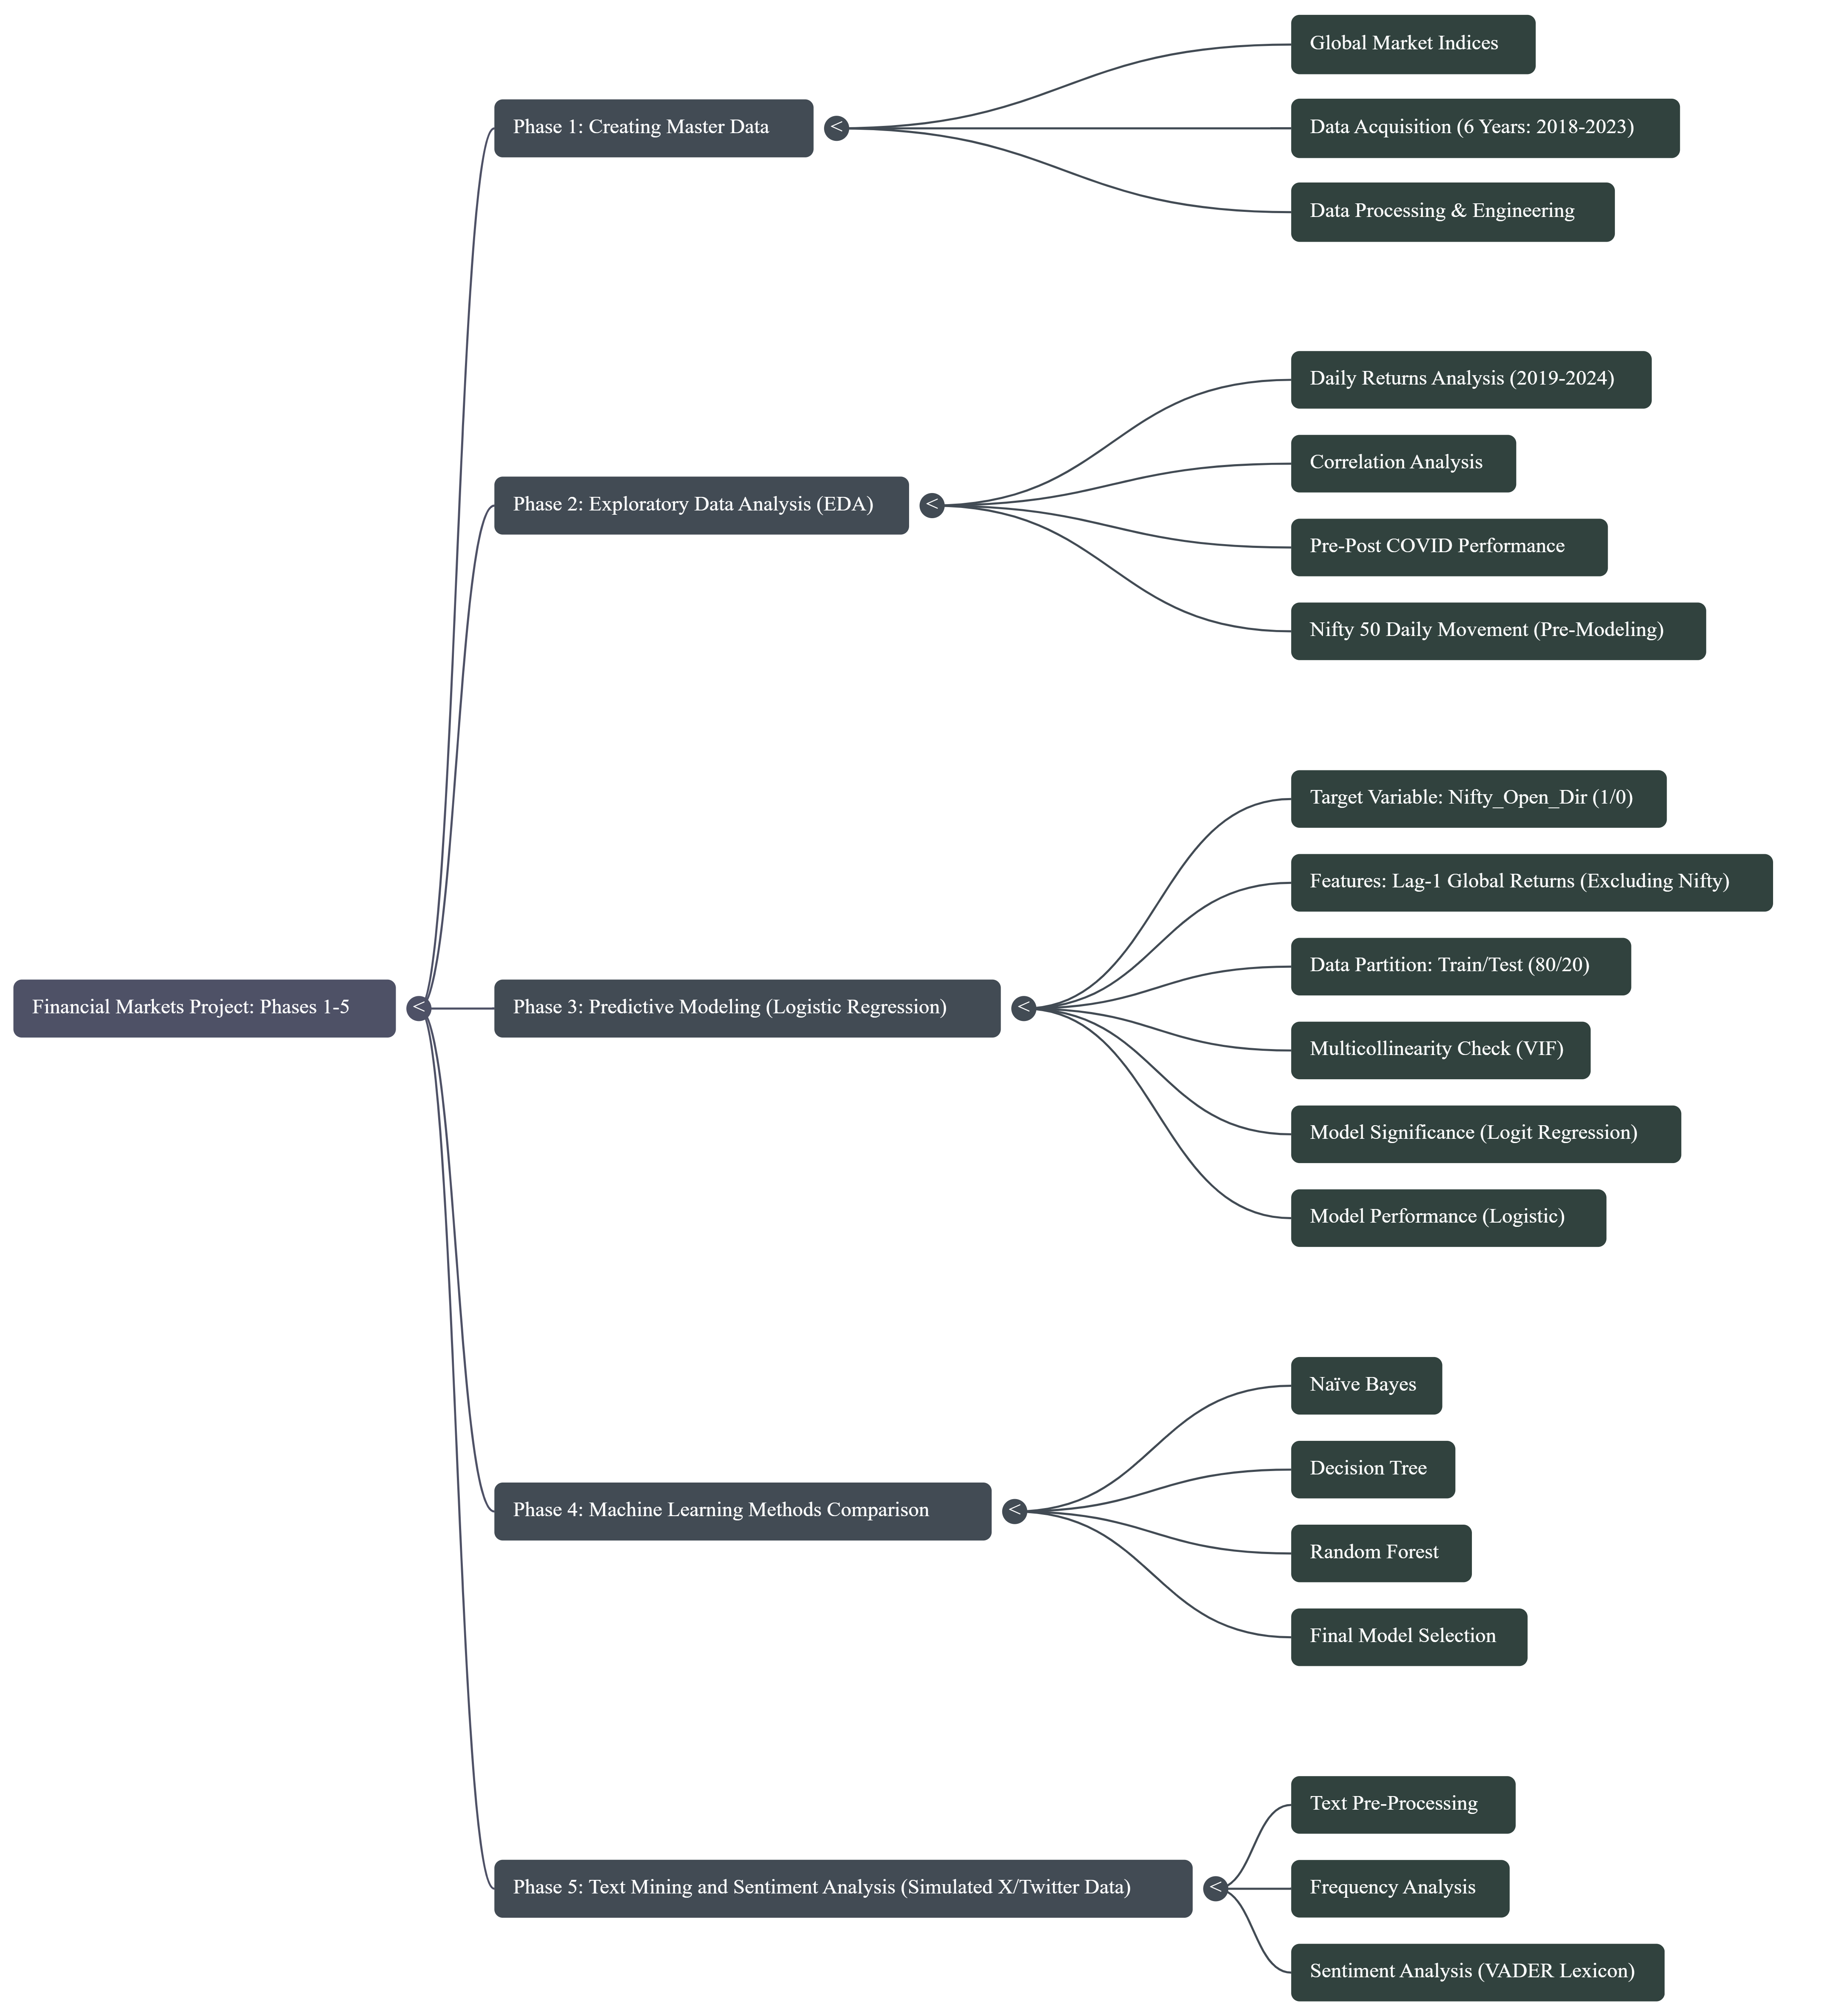
PROJECT PLAN
Phase | Description | Key Deliverables | Deliverables Month
Phase 1: Data Acquisition & Cleaning | Collect OHLC data (6 years), calculate returns, handle missing data, and create indicator variables (Year/Quarter). | Finalized Master Data Table. | end of May 2025
Phase 2: Exploratory Data Analysis (EDA) | Analyze 5-year performance (Box Plots, Summary Tables, Heat Maps), conduct correlation analysis, and analyze pre-post COVID recovery periods. | Correlation Matrices (Full Period & 2024), Recovery Timeline Analysis. | end of May 2025
Phase 3: Binary Logistic Regression | Split data (80/20), run linear model to predict Nifty direction using lagged global returns/VIX, check multicollinearity (VIF), and optimize threshold. | Logit Model with Significant Variables, Train/Test AUC, and Optimal Threshold (0.489) Metrics. | July 2025
Phase 4: Machine Learning Comparison | Apply Naïve Bayes, Decision Tree, and Random Forest methods to the directional prediction task. | Model Comparison Table, Final Model Selection (Random Forest, Test AUC 0.826). | September 2025
Phase 5: Text Mining & Sentiment Analysis | Clean simulated Nifty Twitter/X data, perform tokenization/stopword removal, generate WordCloud, and apply VADER Sentiment Analysis. | Sentiment Distribution Visualizations (Bar Chart, Pie Chart, Histogram). | October 2025

Slide 11

KEY INSIGHTS
The modelling phase showed that global market movements do contain useful signals for anticipating how the NIFTY50 is likely to open on the following day.
Among all approaches tested, the Random Forest model consistently delivered the most reliable predictions, handling the complexity and subtle patterns in the data better than simpler statistical methods.
While no model can perfectly predict short-term market direction, the Random Forest demonstrated a strong ability to separate meaningful trends from noise and remained stable when tested on unseen data.
Overall, the project confirms that combining multiple global indices into a single predictive framework provides a solid foundation for short-term market insight, with the Random Forest emerging as the most dependable choice for this task.

